Slide 1
SUCCESS INSTITUTION
S – Select the goal
U - UNDERSTAND THE knowledge
C –conditioned reflex
C – Challenging carrier
E – enthusiastic attitude
S – Serve the society
S – save the WOrld

Slide 2
1. University Courses
2. Montessori Kindergarten TTC
3. Computer Courses
4. Spoken English
5. Soft Skills
6. Competitve Exams

Slide 3
UNIVERSITY COURSES

Slide 4
UG COURSES:
BA (Tamil & English)
B.SC (maths, physics, Chemistry, Botany, Zoology, costume Design and fashion Technology, visual communications, Computer Science, Catering science & Hotel Mgnt, Information Tech)
B.Com
BBA (logistics & Supply chain Mgnt, Shipping & Port Mgnt, Airline & Airport Mgnt, Airport & Customer Care Mgnt, International Shipping & Aircarge Mgnt)
BCA
BSW

Slide 5
PG COURSES
MA (Tamil & English, History, Economics, Police Administration, Journalism and mass Communication)
MSC (Maths, Physics, Chemistry, Botany, Zoology, Environment Science, Bio-informatics, Computer Science, Applied Psychology, Geography, Information Tech.)
M.Com., M.Com (CA)
MBA (20 Specializations)
MCA
MSW

Slide 6
MBA (20 Specializations)
General
Finacial Management
Hospital Management
Export Management
Enterpreneurship
Finacial Services
Human Resourse
International Bussiness
Information System
Retail Mangement
Tourism & Hotal Management
Investment Management
Market Management
Project Management
Banking & Finance Management
Technology Management
Finance and Account Detail Management
Logistic & Supply Chain Management
Airline and Airport Management

Slide 7
PG DIPLOMA COURSES
BIO INFORMATICS
COMPUTER APPLICATIONS
INSURANCE MANAGEMENT
COMMUNICATIVE ENGLISH
INTERNATIONAL BUSINESS
FIRE & SAFETY MANAGEMENT
LOGISTICS & SUPPLY CHAIN MANAGEMENT

Slide 8
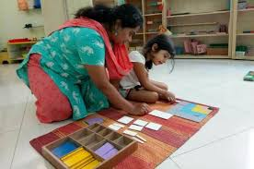
MODERN INTEGRATED SYSTEM
(MONTESSORI KINDERGARTEN &NURSeRY)
Teacher training courses

Slide 9
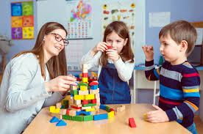
MONTESSORI DIPLOMA AND ADVANCED DIPLOMA COURSES

Slide 10
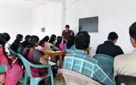
REGULAR & WEEKEND CLASSES (100% PRACTICAL TRAINING)
FREE SPOKEN ENGLISH
UNIVERSAL JOB OPPORTUNITIES
ADDITIONAL SKILL TRAINING

Slide 11
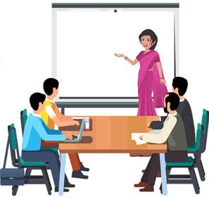
THEORY
Child Psychology And Child Development | Language And Communication Skills
Early Childhood Education | Parent Counseling
Teaching Devices | Nutrition, Child Health And First Aid
Creativity And Craft | School Administration
PRACTICALS
English Album | Math Album
Group Activity | General Knowledge
Teaching Aids (Flash Cards) | Origami Album
Scrap Album | Scroll Box
SCROLL BOX/Chart/Model | Record Book

Slide 12
COMPUTER EDUCATION

Slide 14
COMPUTER COURSES
PGDCA
HDCA
ANIMATION
DCA
SOFTWARE
SPECIALIZATIONS
DTP

Slide 15
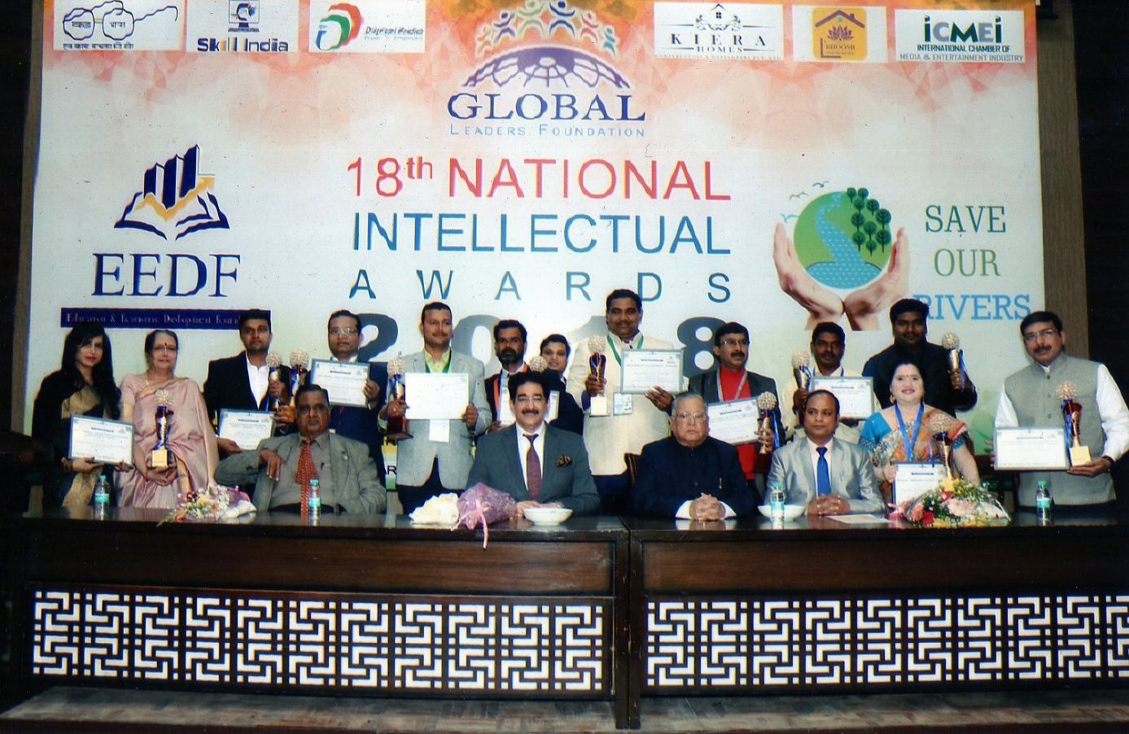
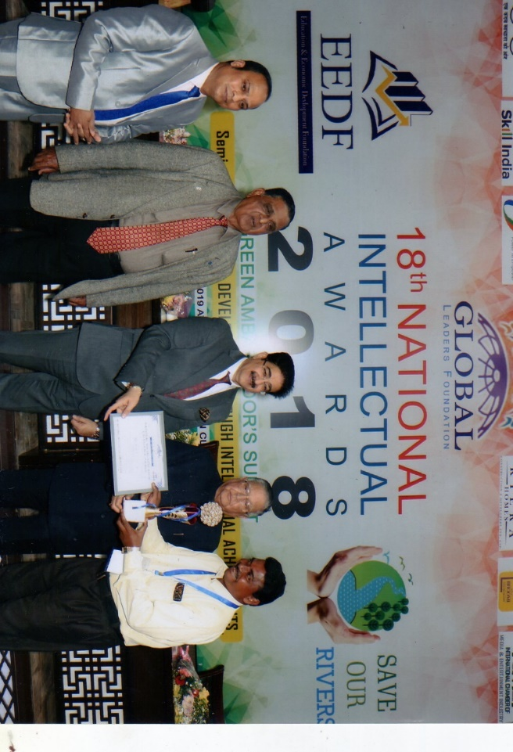
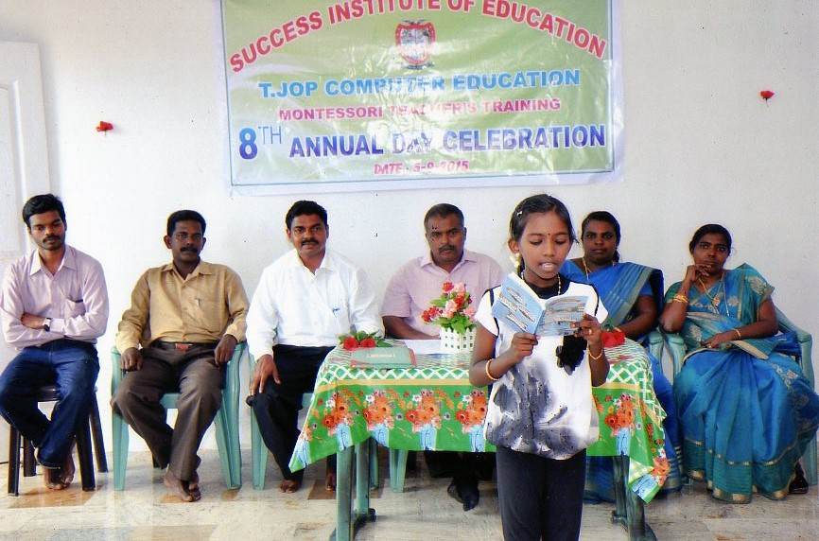
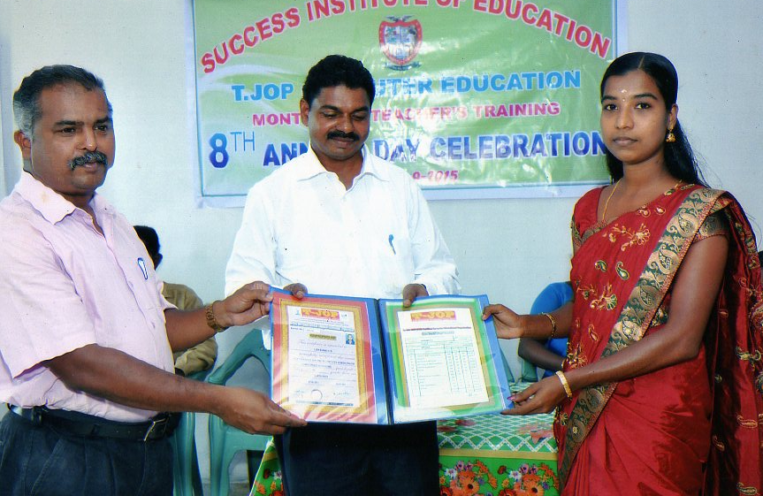
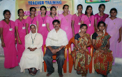
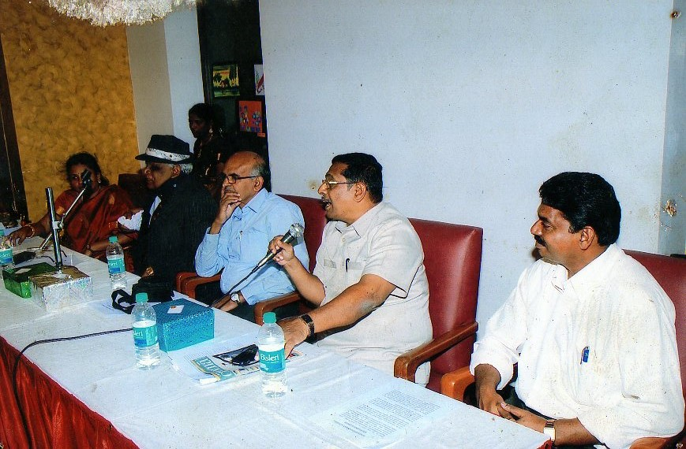

Slide 16
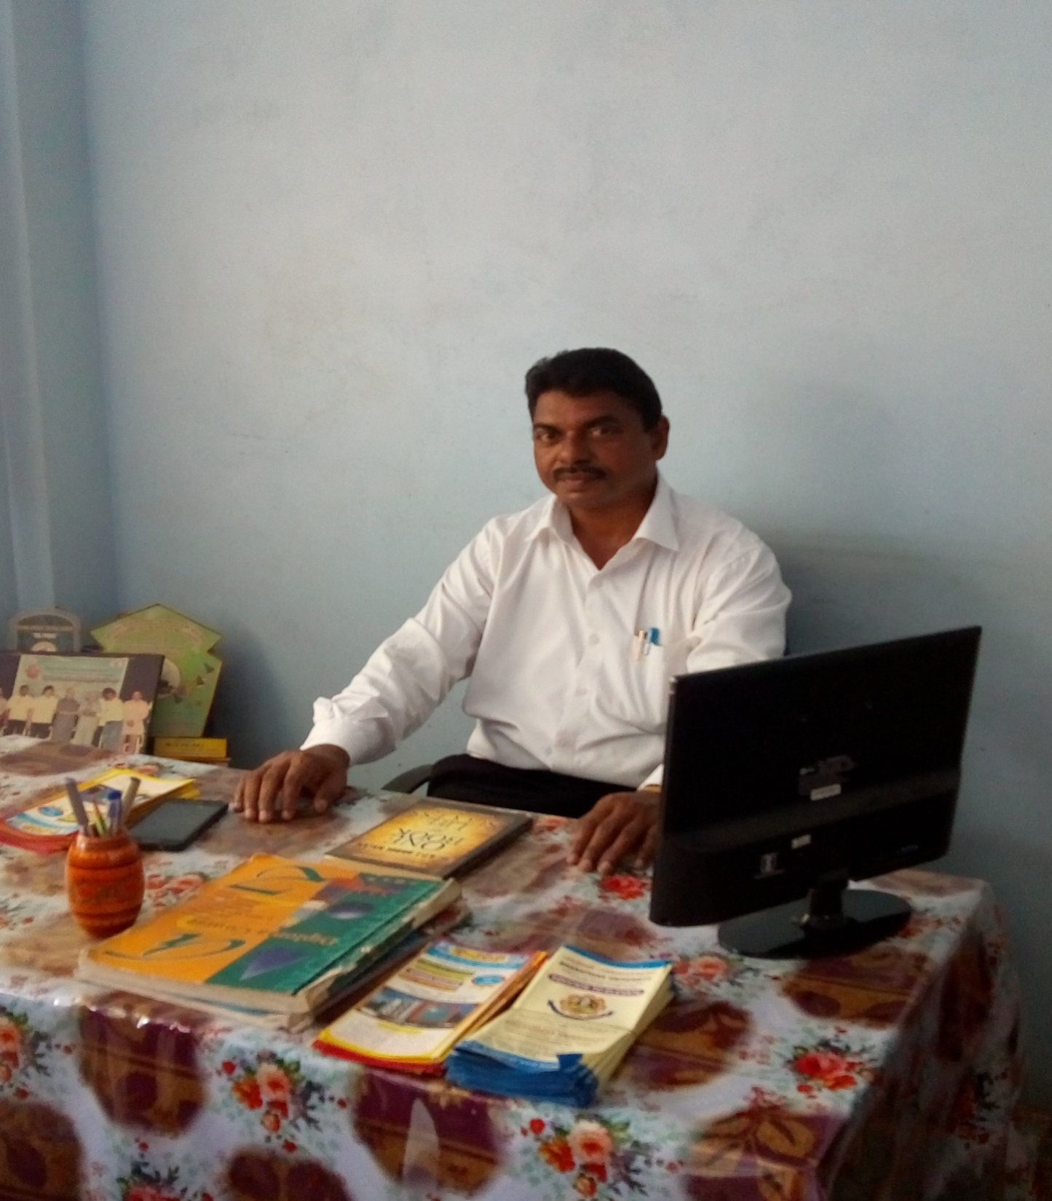
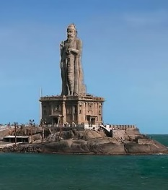
3rd Floor, Lazar Complex,
Near Indian Bank, Market Road Marthandam.
K.K.DIST.
Ph : 04651-274615, 9943627615, 9384731369

